Slide 1
Evaluation of AI Chatbots Using Inverse Sampling Theory
By
Adinath nare 2401

Slide 2
Introduction
AI chatbots are widely used in decision-making and information retrieval
Evaluating their accuracy is critical but computationally expensive
Traditional evaluation uses full datasets (complete enumeration)
Sampling theory provides an efficient alternative
This study applies statistical sampling to AI system evaluation

Slide 3
Problem Statement
Chatbot errors are relatively infrequent events
Measuring error probability directly requires large datasets
Fixed-sample methods may waste effort when errors are rare
We need a method that adapts to occurrence of errors
Objective: estimate error probability efficiently

Slide 4
Objective of Study
Estimate error probability of chatbots using sampled data
Compare performance between two AI systems
Use only sampling distributions and probabilistic methods
Avoid full dataset evaluation
Demonstrate practical application of inverse sampling

Slide 5
Dataset collection
Dataset consists of multiple-choice and multi-select questions
refered from (Stochastic processes and Probability Theory book)
Each question was posed independently to all chatbots
Responses were recorded in a structured dataset
Each response was compared with the correct answer
Two chatbots evaluated:
Gemini
Claude
Dataset randomly shuffled to ensure independence

Slide 6
Error Definition
Each response treated as a Bernoulli trial
Outcome defined as:
Error = 1 (incorrect response)
Correct = 0
Error occurs if:
Missing correct options
Selecting incorrect options
Ensures objective and consistent evaluation

Slide 7
Inverse Sampling
Inverse sampling is a sequential sampling method where the number of successes (errors) is fixed in advance
Instead of fixing sample size n, sampling continues until a pre-specified number of errors r is observed
The total number of trials N required to reach r errors is a random variable
Under this framework, N follows a negative binomial distribution, modeling the number of trials needed to observe r failures
This approach is particularly useful when the event of interest (error) has low or unknown probability, as it avoids unnecessary sampling

Slide 8
Methodology
Randomize dataset to approximate independent trials
Compute cumulative sum of errors
Stop when cumulative errors reach r=20
Record total number of questions N
Estimate error probability using r/N

Slide 9
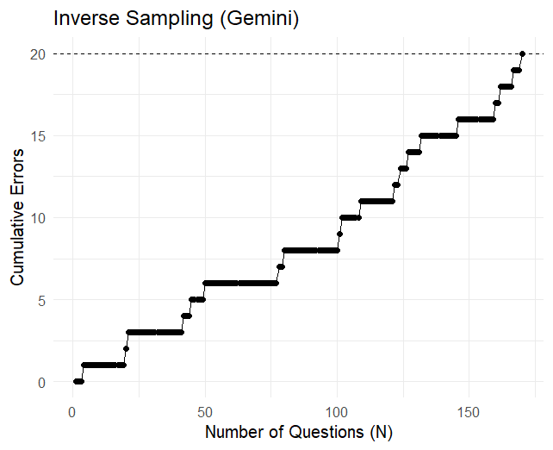
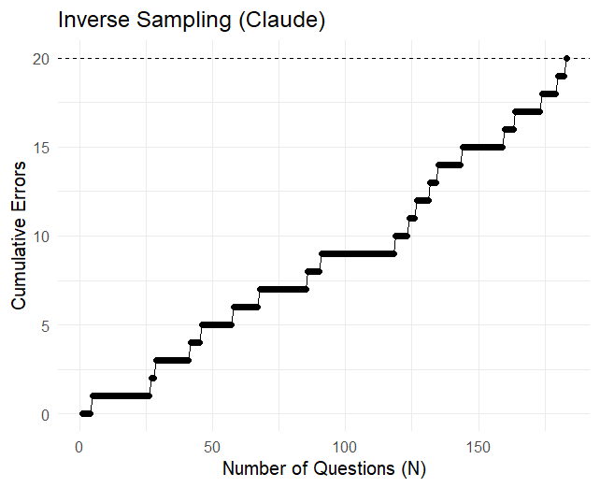

Slide 10
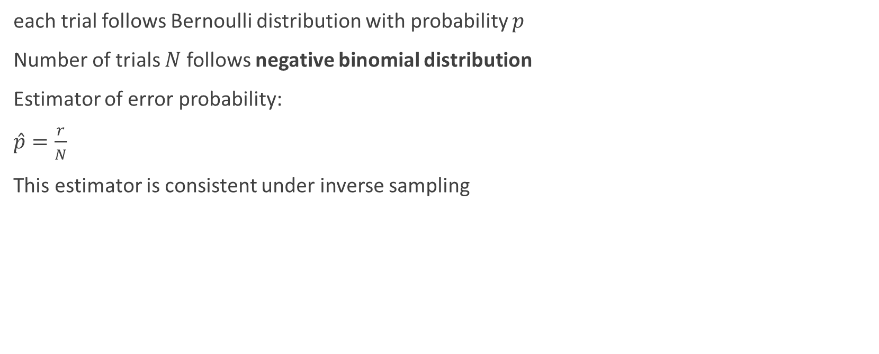
Statistical Model
each trial follows Bernoulli distribution with probability $p$
Number of trials $N$ follows negative binomial distribution
Estimator of error probability:
$\hat{p}=\frac{r}{N}$
This estimator is consistent under inverse sampling

Slide 11
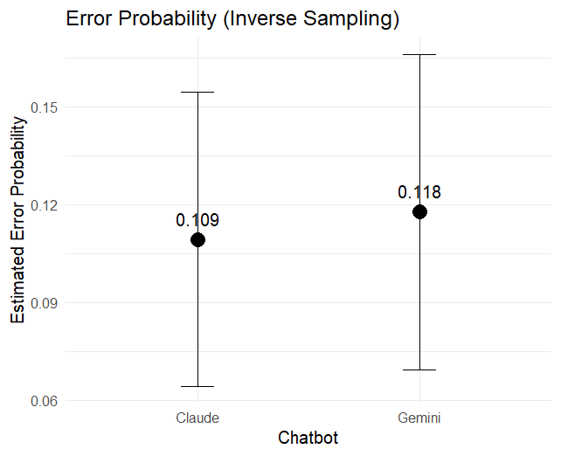

Slide 12
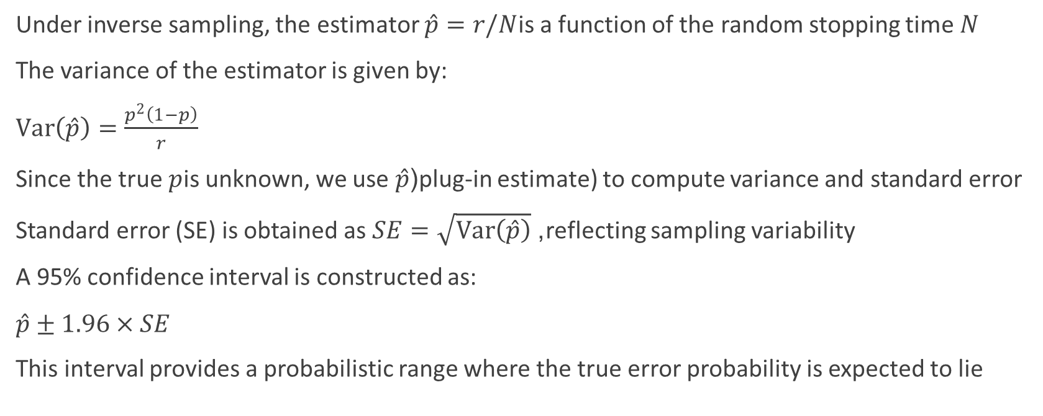
Variance and Confidence Interval
Under inverse sampling, the estimator $\hat{p}=r/N$is a function of the random stopping time $N$
The variance of the estimator is given by:
$Var\left(\hat{p}\right)=\frac{p^{2}\left(1−p\right)}{r}$
Since the true $p$is unknown, we use $\hat{p}$(plug-in estimate) to compute variance and standard error
Standard error (SE) is obtained as $SE=\sqrt{Var\left(\hat{p}\right)}$, reflecting sampling variability
A 95% confidence interval is constructed as:
$\hat{p}±1.96×SE$
This interval provides a probabilistic range where the true error probability is expected to lie

Slide 13
result
Inverse Sampling Results (r = 20):
Chatbot | r | N | p̂ (Error Prob.) | SE | 95% CI
Gemini | 20 | 170 | 0.118 | 0.0247 | (0.069, 0.166)
Claude | 20 | 183 | 0.109 | 0.0231 | (0.064, 0.154)
Both chatbots have approximate similar estimated error probabilities
Claude shows a slightly lower estimate, indicating marginally better performance
However, the confidence intervals overlap significantly, suggesting no clear difference
Standard errors are relatively small, indicating moderate precision of estimates
Differences observed are within expected sampling variability

Slide 14
Our observation
Inverse sampling adapts sampling effort to system performance
Better systems require more trials to observe errors
Method avoids unnecessary data collection
Demonstrates practical use of sampling theory in AI evaluation

Slide 15
Limitations
Error rates are moderate, not extremely rare
Assumes independence of responses
Based on a single randomized sequence
Results may vary across different samples

Slide 16
Conclusion
Inverse sampling successfully applied to chatbot evaluation
Provides efficient estimation of error probabilities
Both chatbots show similar performance statistically
Methodology can be extended to larger AI systems

Slide 17
Thank You

